Slide 1
Building Consumer Confidence During COVID-19
Marketing Roadmap
Understanding the patient journey
Messaging across the marketing “ecosystem”
What tools to leverage and how
Building a marketing roadmap
Q & A
Notes:
So, at this time, I would like to start by introducing myself. For those of you that do not know me, my name is Suzette Sison, and I am the Senior Director of Marketing for PE. I’ve been specializing in marketing now for over 20 years with half my career focused within the healthcare sector working closely with providers, hospitals, health systems and payers to implement and license patient engagement and population health management platforms and content. And most recently, for the past few years before I joined PE, I was working as a marketing consultant to help direct and manage large digital marketing efforts for a reputation management vendor to help physicians and practices enhance their online presence and rankings and support their growth efforts. I am extremely focused on digital marketing and leveraging my expertise and skills here at PE to support all of you.
I joined late January so I was here about two months before the Coronavirus pandemic hit us. So needless to say, it’s been a unique couple of months for myself and us all.
Today, our work has never been as challenging as it is now during COVID-19 but the good news is your marketing efforts is a great tool – during this time of uncertainty – to help you move forward.
So what I will be covering is general marketing best practices that pre-COVID-19 should be in place and if not already in place

Slide 2
33% percent of consumers surveyed report feeling unsafe going to their doctors office.
Patients Are Anxious About Seeking Healthcare
Fear is keeping people away from doctors offices, causing them to delay or avoid care for chronic illnesses or injury.
Sage Growth Partners / Blackbook Research, May 2020¹
More than half of respondents have access to telehealth and of those who have used it, 78% were satisfied with their experience. BUT age and income are factors. More than 80% of patients over the age of 55 who have access to telehealth have not used it.
49% of men preferred video visits compared with only 30% of women.
Are you communicating with patients about the safety of your office?
Are you using telehealth? Can/should you expand?
How are you accounting for differences between men/women, older/younger demographics?
http://go.sage-growth.com/covid-19-market-report
Notes:
Patient Engagement is critical today in your marketing efforts. It’s not a new concept but as we are all living and working through a new normal we do have to do things bit differently. So I’ve highlighted some key statistics to review:
1.) Ongoing patient communications leveraging technology will be key as you can see it improves patient engagement by 60% or higher
2.) I will be talking about ways to deliver these communications and making sure your communications are mobile-friendly as 57% of email opens happen on a mobile device or tablet.
3.) Patients just like any consumer is looking for convenience instantaneously that’s why it’s important you are online to meet their needs and you have online scheduling tools and applications to provide flexibility.
4.) Over 94% of healthcare patients are evaluation providers online. While patients are typically not shopping for surgery centers, once their physician recommends a center they will look online to see the location, check out information.
At this time goal is to help patients navigate through the uncertainty and build trust and make them feel secure and informed in their healthcare decisions.
It’s important to do an assessment of your key marketing priorities and see what you have in place today against these current trends. While volumes are low, this Is a great opportunity to re-think or re-tool your marketing communications and see what ways you can support your efforts to build up activities and ramp up.

Slide 3
Facilitating ongoing communication between patients and physicians via apps and online portal can improve engagement rates by 60% or higher.¹
Communication and Transparency Build Trust
Drives better quality of care for patients and a better experience for both patients and physicians.
Mobile-friendly communication is crucial for patient engagement, as 57% of total email opens happen on a mobile device or tablet.²
68% of healthcare patients say they are more likely to choose a provider that offers ability to book, change or cancel appointments online.³
94% of healthcare patients use online reviews to evaluate providers.⁴
http://www.mhealthnews.com/news/using-survey-patient-engagement-tool
http://www.televox.com/blog/outreach-opportunities/two-stats-that-support-email-as-an-engagement-opportunity/
https://www.patientpop.com/blog/infographics/infographic-online-scheduling/
https://www.softwareadvice.com/resources/how-patients-use-online-reviews/
Notes:
Patient Engagement is critical today in your marketing efforts. It’s not a new concept but as we are all living and working through a new normal we do have to do things bit differently. So I’ve highlighted some key statistics to review:
1.) Ongoing patient communications leveraging technology will be key as you can see it improves patient engagement by 60% or higher
2.) I will be talking about ways to deliver these communications and making sure your communications are mobile-friendly as 57% of email opens happen on a mobile device or tablet.
3.) Patients just like any consumer is looking for convenience instantaneously that’s why it’s important you are online to meet their needs and you have online scheduling tools and applications to provide flexibility.
4.) Over 94% of healthcare patients are evaluation providers online. While patients are typically not shopping for surgery centers, once their physician recommends a center they will look online to see the location, check out information.
At this time goal is to help patients navigate through the uncertainty and build trust and make them feel secure and informed in their healthcare decisions.
It’s important to do an assessment of your key marketing priorities and see what you have in place today against these current trends. While volumes are low, this Is a great opportunity to re-think or re-tool your marketing communications and see what ways you can support your efforts to build up activities and ramp up.

Slide 4
Practice and or Center Key Priorities
Communicating Safety for Procedure or In-Office Visits
EXTERNAL TOOLS
INTERNAL TOOLS
Website
Email marketing
Reputation management
Social media
Thought leadership
Public relations
Office phone greetings/hold messages
Appointment reminders
Staff education & scripting
Registration & other materials
Patient portal communications
Signage
Notes:
To help re-opening and ramp up, Marketing has created communication and obtained content from ASCA to support our efforts.

Slide 5
Practice/Center Protocols
Your Staff is the Front Line of your Patient’s Experience and Care
Address staff and patient safety to continue to deliver quality patient care
Train and prepare staff on safety protocols
Display safety signage to ensure compliance (ASCA Tool Kit)
Create an optional specialized statement on safety measures and protocols to push to patient portal in advance of appointments
Notes:
Ensure PPE training enforced with staff and patients have information on safety measures, etc.

Slide 6
Best Practice Approach
Our environments look different
WE look different
Clear communications
Build trust with patient outreach to help anxious patients feel comfortable and understand all new safety protocols in place and what to expect.
Consistent messaging across all channels
Highlight new safety measures and protocols across various digital channels and showcase in adherence to state and federal guidelines
Deliver on your “promise” in ways patients can see and feel good about
Address staff and patient safety with PPE training and review all new cleanliness protocols and regimens to help patients feel confident in your efforts to ensure their safety.
Notes:
So now that I’ve covered general marketing best practices and opportunities, I wanted to break it down on key strategies to leverage and consider now as we get through ramping up and re-opening during this COVID-19 timeframe.
Ultimately the goal is to build trust with the patients to have them feel comfortable on coming on site for an appointment or procedure.
Key areas of focus
Clear Communications that showcase the re-open target dates and new safety measures and protocols in place
Communications online – Website notifications, Listing updates and Social Media content to highlight adherence to state and federal guidelines on safety
Practice and Center protocols formalized within patient intake and published and communicated via the communication resources
Resources to consider:
Emails
Website
Business Listings
Social Media Content

Slide 7
Messaging Matrix
 | Website | Email | Portal | Phone/ hold msg | Web listings | Social | Signage | Staff
Safety measures | X | X | X | X | X | X | X | X
Telehealth | X | X | X | X | X | X |  | X
Location status/hours | X | X |  |  | X |  |  | X
General health/wellness | X | X |  |  |  | X

Slide 8
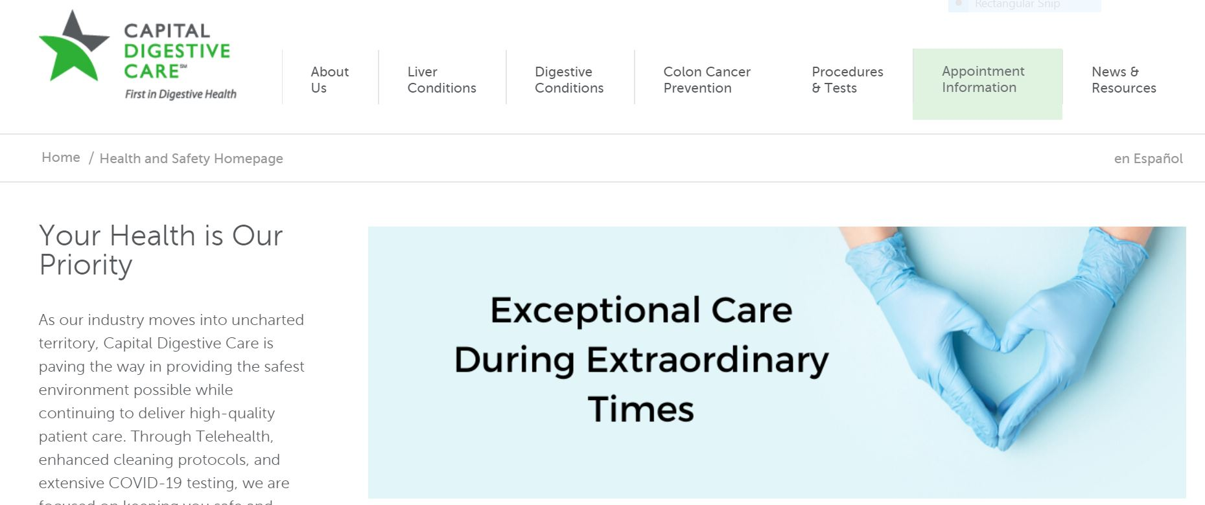
Website Updates

Slide 9
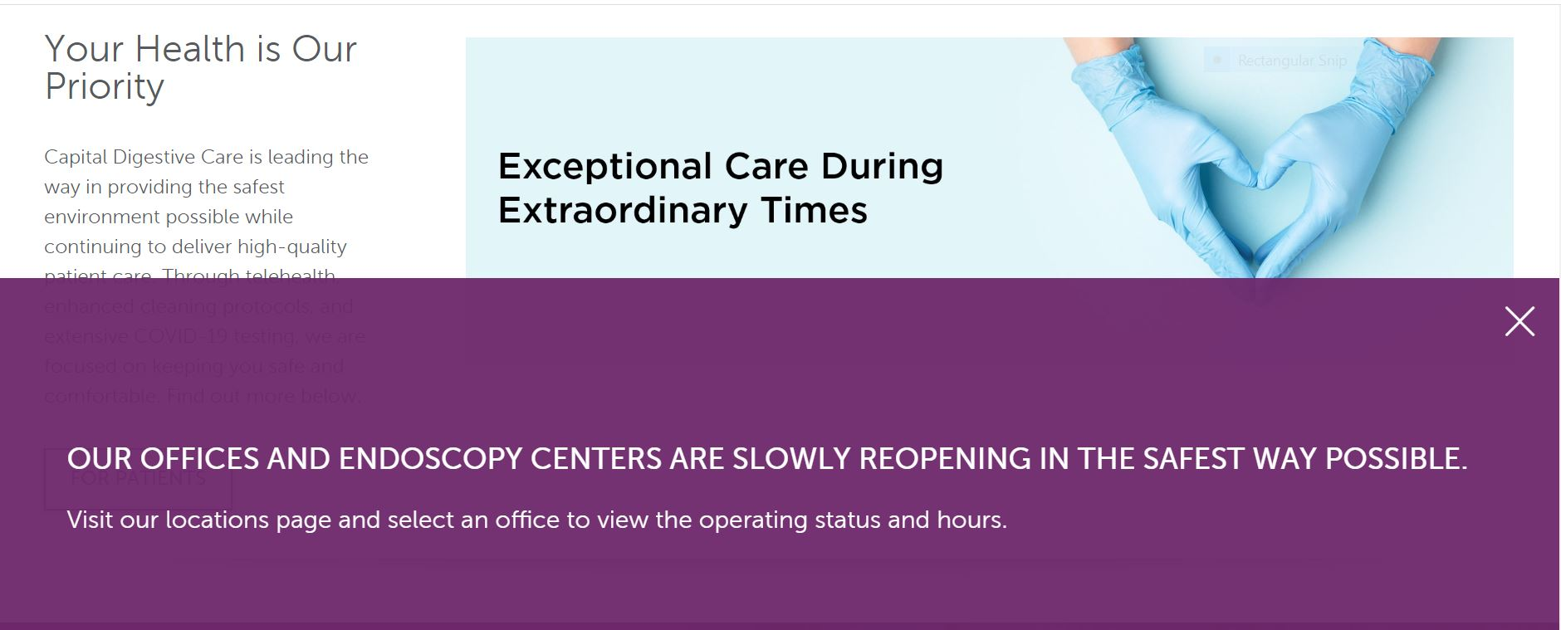
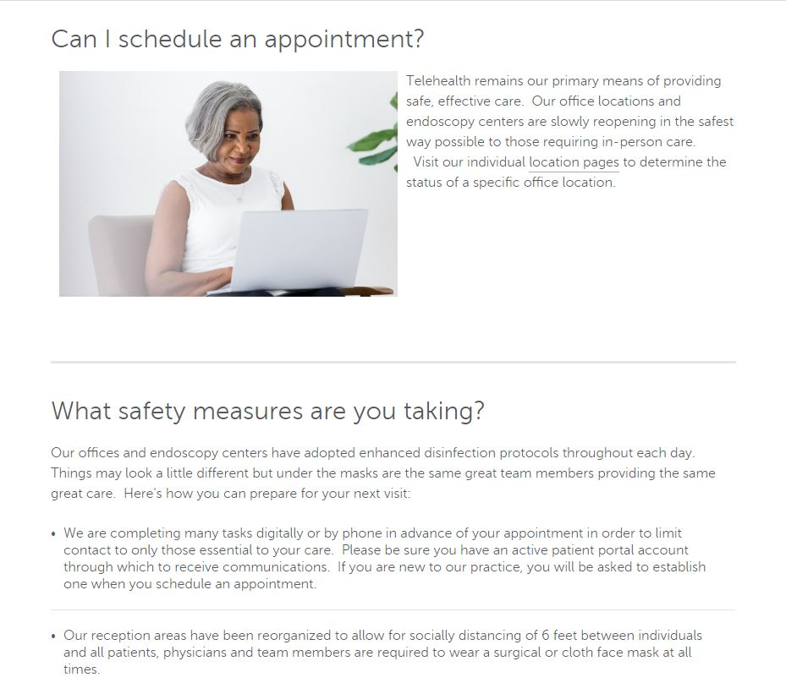
Practical Tips
Website Alert or Pop-up Messaging
Dedicated Health & Safety page or
blog post
Post New/Revised Materials
Update Location Status/Hours of Operation
Notes:
The healthcare journey often begins online – your website is the first interaction with a potential patient
Ensure safety messaging front and center. Consider if not already added, pop-up messaging on your commitment to health and safety. Link to Coronavirus folder

Slide 10
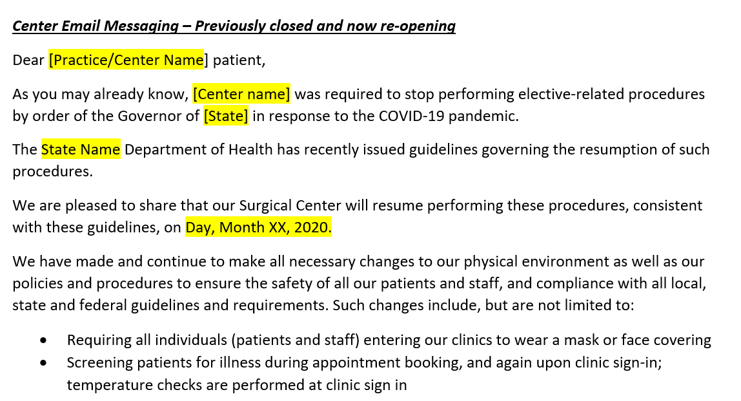
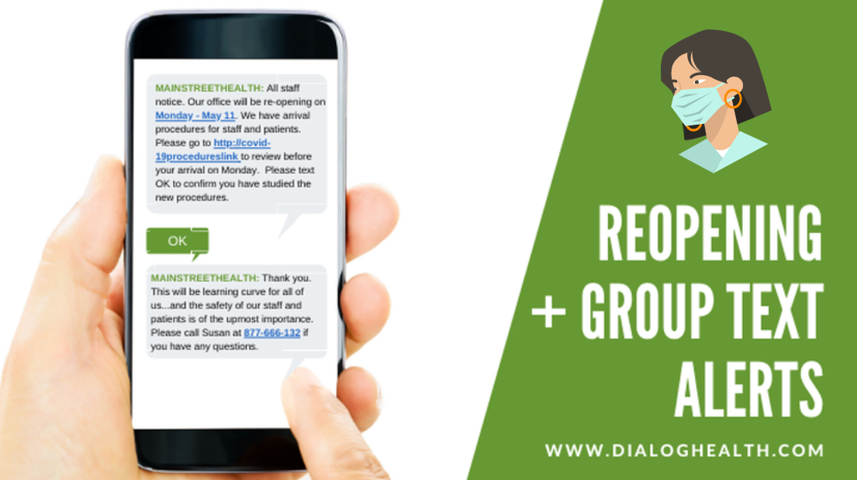
Patient Outreach
Emails and Texts Most Effective Patient Communications
Publish re-open dates along with commitment to safety. “We’re Open. We’re Safe. We’re here for you.”
Email messages to announce re-open date, reinforce new safety measures and to not delay care
Links to COVID-19 Page and FAQs with important Pre- and Post Procedure information
Include new updates along with SMS Text messages
Notes:
Emails and Text Messaging copy has been crafted and saved in the coronavirus folders
Messaging templates are included for you to version based on your center specific protocols.

Slide 11
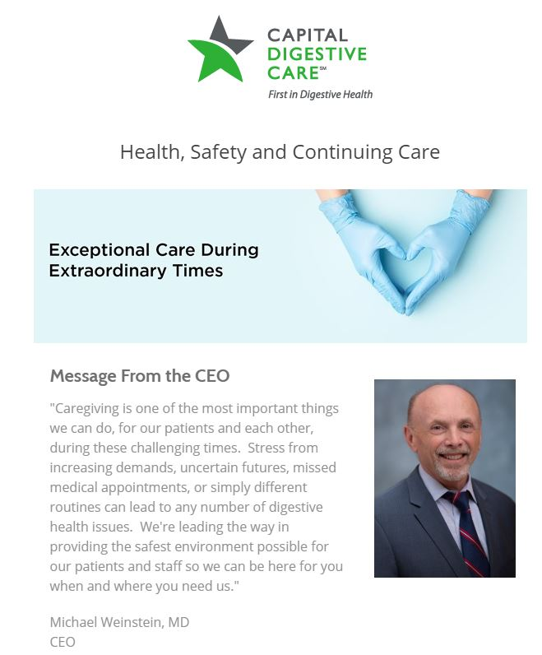
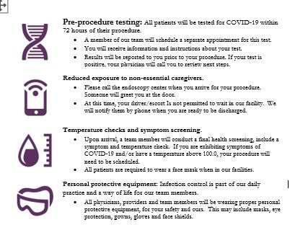
Patient Outreach: Email, Portal, Appointment Reminder

Slide 12
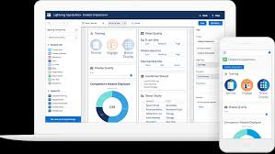
Practical Tips
Keep messaging consistent
Less is more: stick to key information
Use commercial tools for ease & tracking
Link to or provide contact info for
follow-up
Consider different messages for
different audiences
Notes:
The healthcare journey often begins online – your website is the first interaction with a potential patient
Ensure safety messaging front and center. Consider if not already added, pop-up messaging on your commitment to health and safety. Link to Coronavirus folder

Slide 13
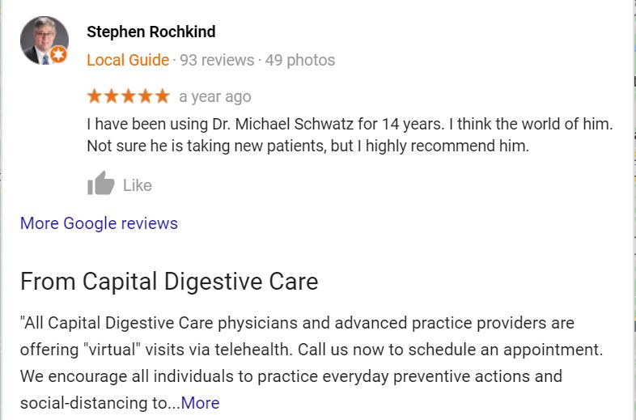
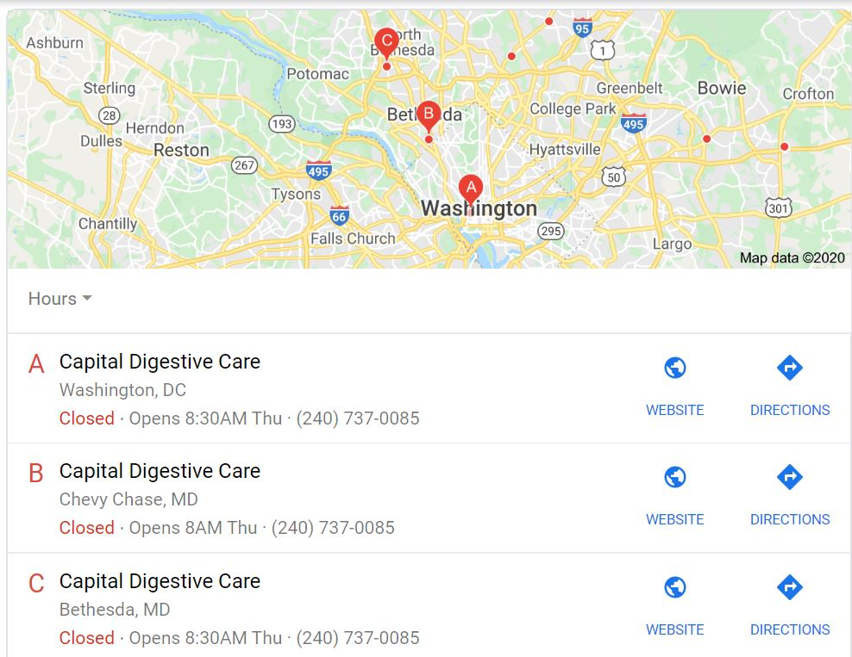
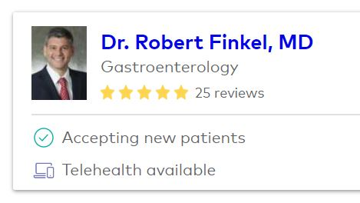
Reputation & Listing Management
Practical Tips
Claim your listings
Leverage special features
Add pictures
Keep listings accurate
Consider different messages for different audiences
Notes:
The healthcare journey often begins online – your website is the first interaction with a potential patient
Ensure safety messaging front and center. Consider if not already added, pop-up messaging on your commitment to health and safety. Link to Coronavirus folder

Slide 14
Social Media
Use your Social Media Pages to Promote Health, Wellness and Safety
Include COVID-19 Related links to website on social media – ASCA Social Media Kit
Publish special messages on re-opening hours and or specific locations
Post pictures of staff wearing masks, handwashing or use infographics
Reinforce safety measures and new protocols

Slide 15
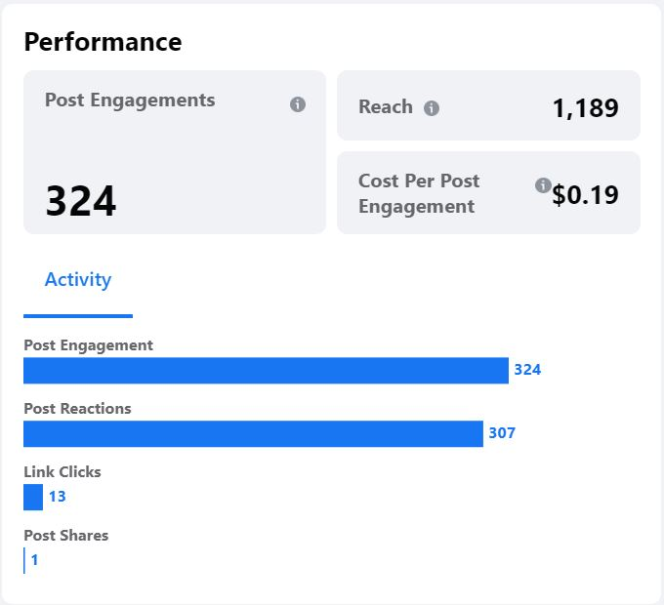
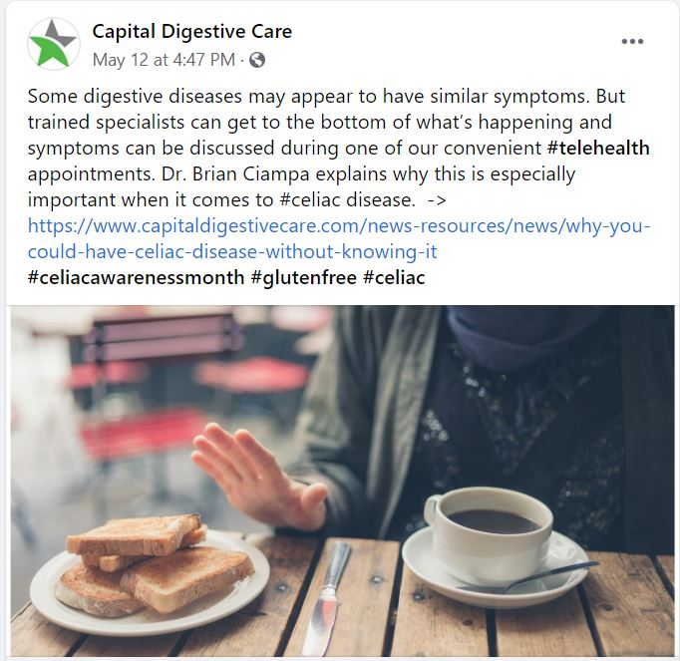
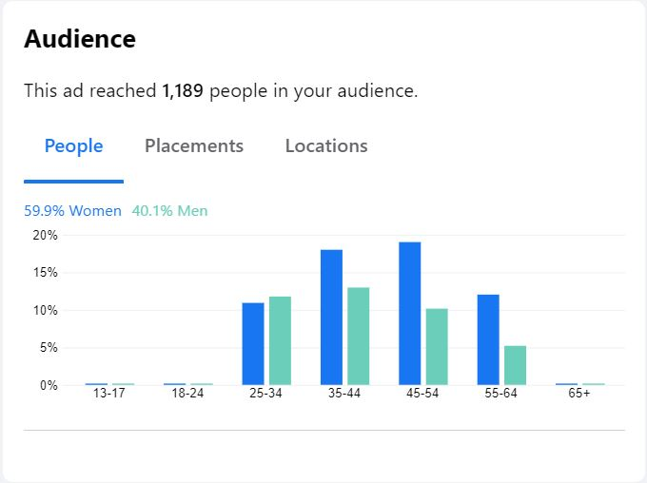
Social Media: Performance Metrics

Slide 17
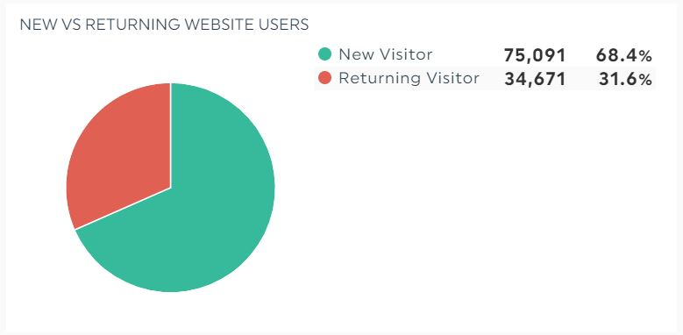
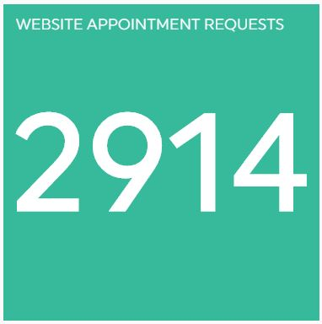
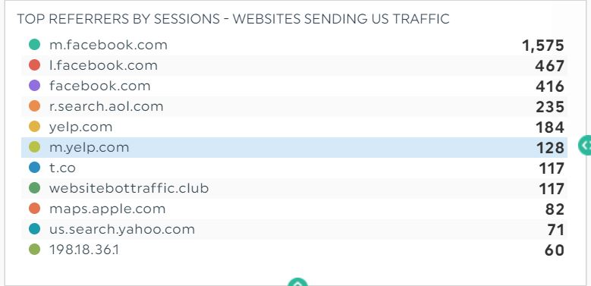
Ecosystem: A complex network or interconnected system
Measuring Success

Slide 18
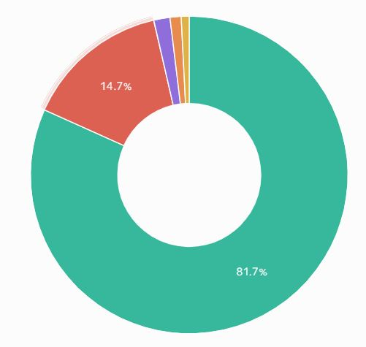
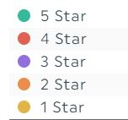

Slide 19
Economical resources for programs of any size
Resources & Tools
Trade Secrets!
DashThis (reporting)
Venngage (graphic design tool)
GoogleMyBusiness (physician & location listings)
TruDigital (digital signage)
Email Marketing
ConstantContact
CampaignMonitor
SalesForce
Notes:
The healthcare journey often begins online – your website is the first interaction with a potential patient
Ensure safety messaging front and center. Consider if not already added, pop-up messaging on your commitment to health and safety. Link to Coronavirus folder

Slide 20
Understand the patient journey unique to you
Thank You!
Identify areas to target and types information and messaging to share
Increase patient engagement
Cara Reymann
SVP, Practice Operations & Marketing
PE Practice Solutions
Capital Digestive Care
Increase patient engagement opportunities to help anxious patients feel more comfortable and informed
Build trust and confidence
Implement marketing best practices and ensure key COVID-19 communication efforts incorporated into marketing
Help patients and staff feel confident in your efforts to ensure that their health and safety top priority
Cara.Reymann@capitaldigestivecare.com
Notes:
So now that I’ve covered general marketing best practices and opportunities, I wanted to break it down on key strategies to leverage and consider now as we get through ramping up and re-opening during this COVID-19 timeframe.
Ultimately the goal is to build trust with the patients to have them feel comfortable on coming on site for an appointment or procedure.
Key areas of focus
Clear Communications that showcase the re-open target dates and new safety measures and protocols in place
Communications online – Website notifications, Listing updates and Social Media content to highlight adherence to state and federal guidelines on safety
Practice and Center protocols formalized within patient intake and published and communicated via the communication resources
Resources to consider:
Emails
Website
Business Listings
Social Media Content

